Slide 1
The Hidden Power of Technical SEO
ME. EMI.

Slide 2
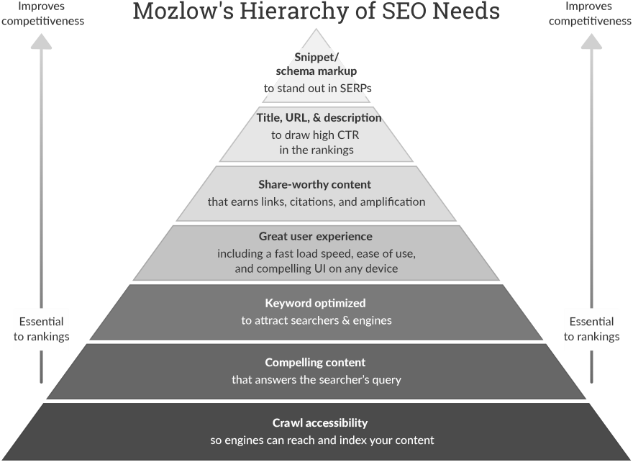
1
#WordCampSkopje2019 @emilijagjorgjevska

Slide 3
Defining Technical SEO
Technical SEO refers to the process of optimizing your website for the crawling and indexing phase. It helps search engines access, crawl, interpret and index your website without any problems.
2
#WordCampSkopje2019 @emilijagjorgjevska

Slide 4
CONTENT STRATEGY
TECHNICAL
SEO
SEO
DIGITAL PR &
LINK BUILDING
3
#WordCampSkopje2019 @emilijagjorgjevska

Slide 5
THE TRUTH IS...
4
#WordCampSkopje2019 @emilijagjorgjevska

Slide 6
EVERY SEO CAN BE TECHNICAL
it’s not only crawling and indexing
5
#WordCampSkopje2019 @emilijagjorgjevska

Slide 7
WHAT THE ….?
6
#WordCampSkopje2019 @emilijagjorgjevska

Slide 8
TECHNICAL SEO = BENEFITS = OUTPERFORMING
7
#WordCampSkopje2019 @emilijagjorgjevska

Slide 9
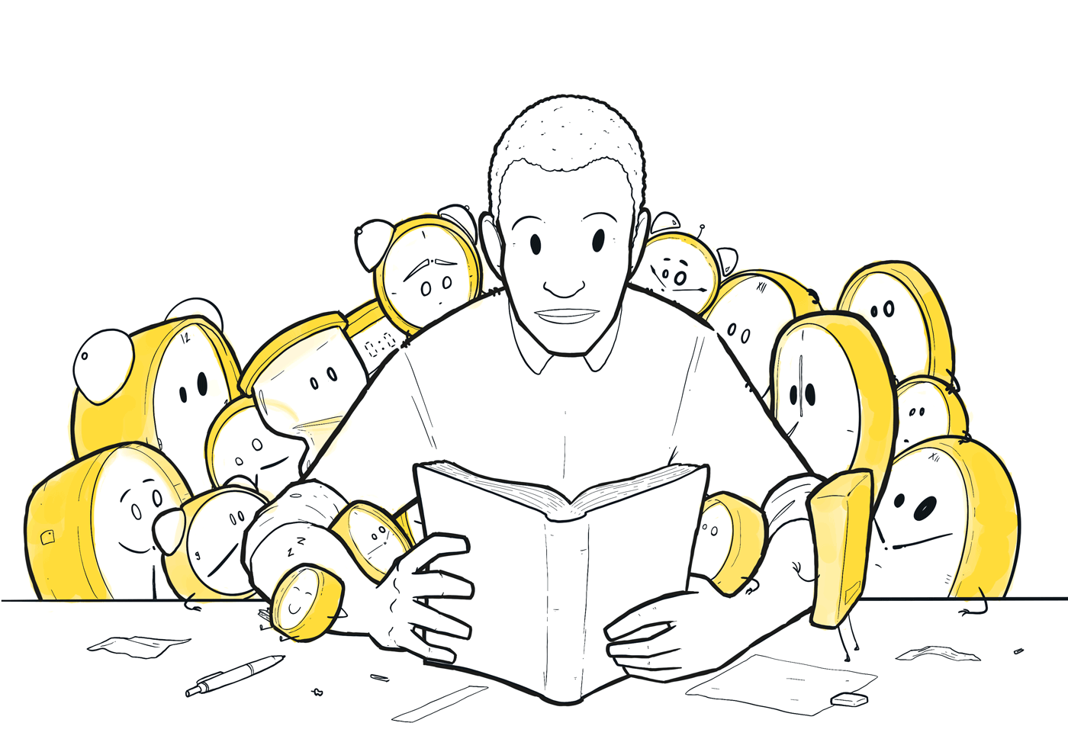
I’LL EXPLAIN.
8
#WordCampSkopje2019 @emilijagjorgjevska

Slide 10
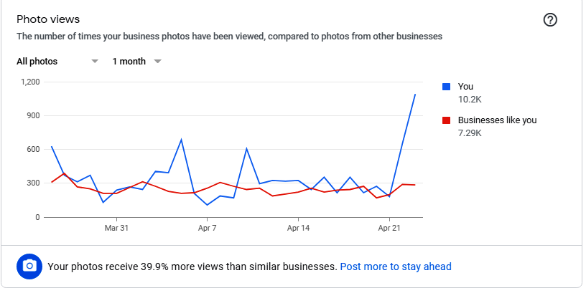
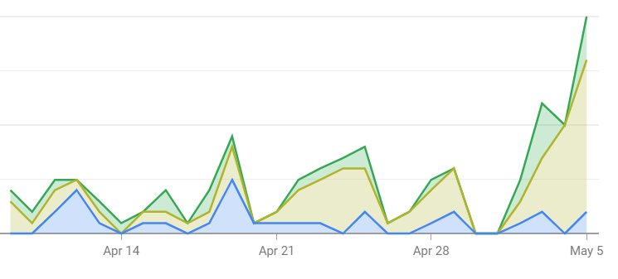
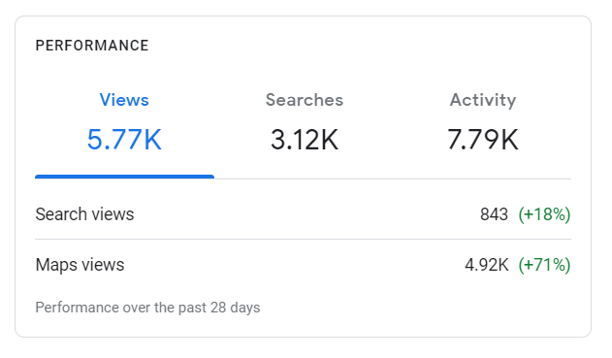
9
#WordCampSkopje2019 @emilijagjorgjevska

Slide 11
Macedonian Idol Finalist.
Computer Science Student.
PR of EESTEC.
Freelance Content Writer.
Applied e-Technologies Student.
Technical SEO Engineer.
LinkedIn Valued Member.
MSc of Intelligent Systems.
10
#WordCampSkopje2019 @emilijagjorgjevska

Slide 12
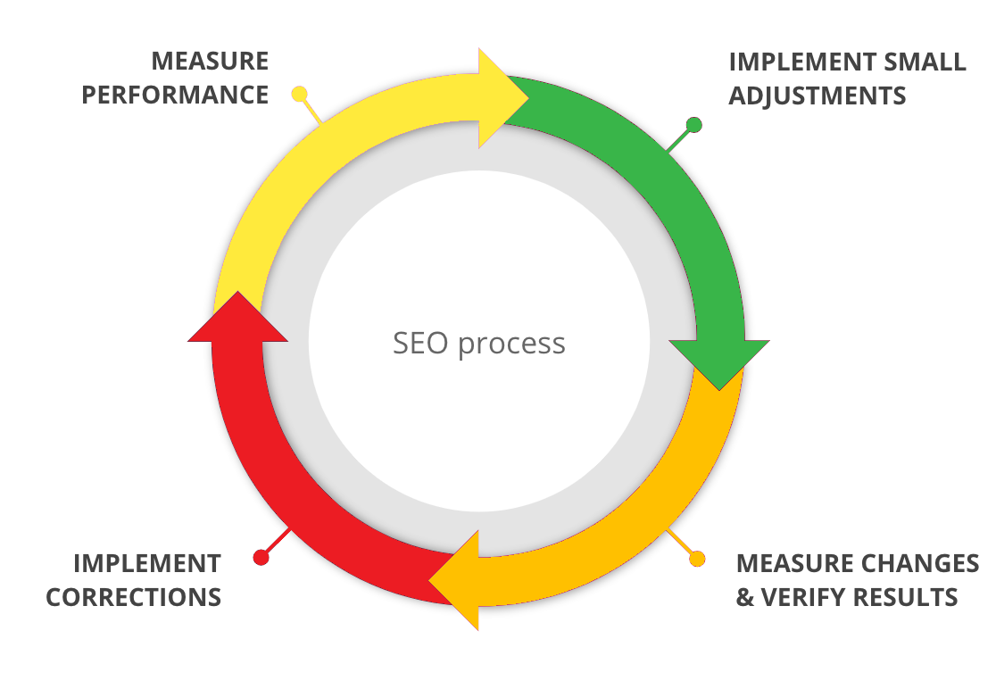
11
#WordCampSkopje2019 @emilijagjorgjevska

Slide 13
OVERVIEW OF THE MOST IMPORTANT PARTS
12
#WordCampSkopje2019 @emilijagjorgjevska

Slide 14
UNLEARNING. RELEARNING.
13
#WordCampSkopje2019 @emilijagjorgjevska

Slide 15
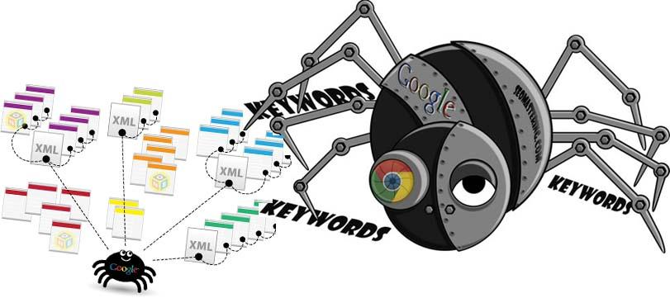
14
#WordCampSkopje2019 @emilijagjorgjevska

Slide 16
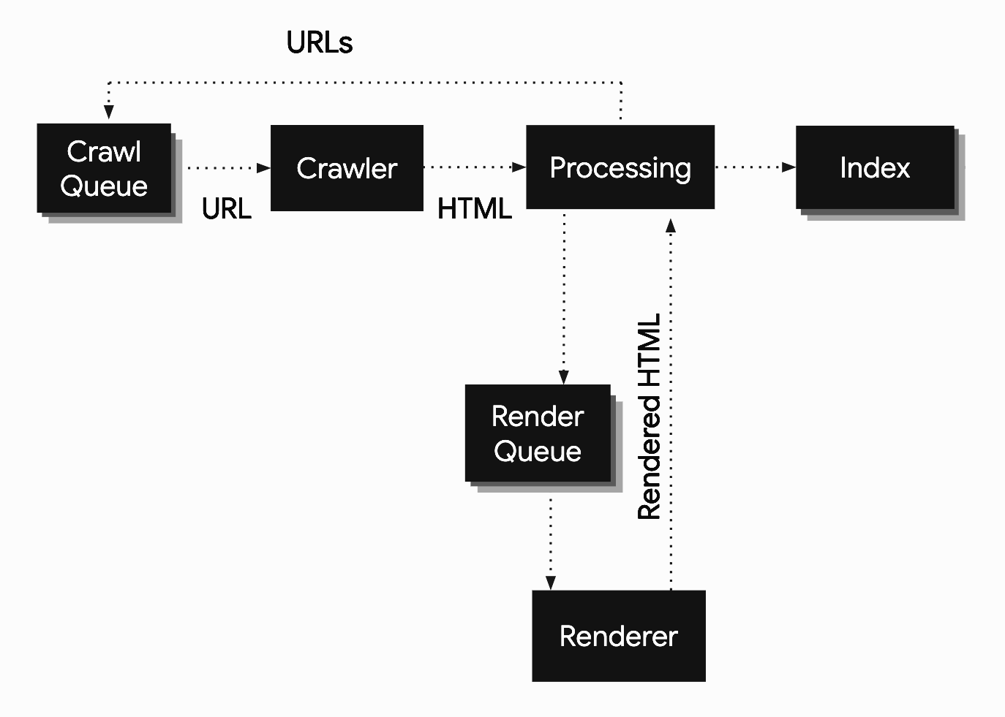
15
#WordCampSkopje2019 @emilijagjorgjevska

Slide 17
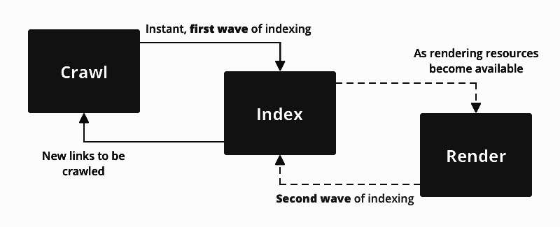
Instant, first wave of indexing
As rendering resources
become available
Crawl
Index
Render
New links to be
crawled
Second wave of indexing
16
#WordCampSkopje2019 @emilijagjorgjevska

Slide 18
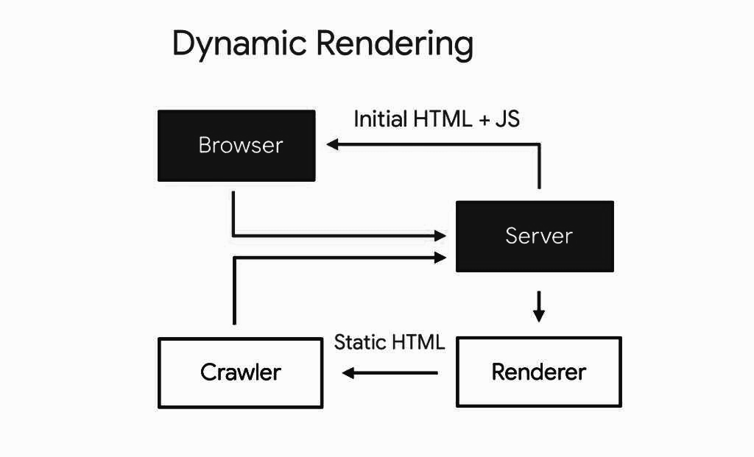
Initial HTML + JS
Browser
Server
Static HTML
Crawler
Renderer
17
#WordCampSkopje2019 @emilijagjorgjevska

Slide 19
BENEFIT: HAPPY BOTS
18
#WordCampSkopje2019 @emilijagjorgjevska

Slide 20
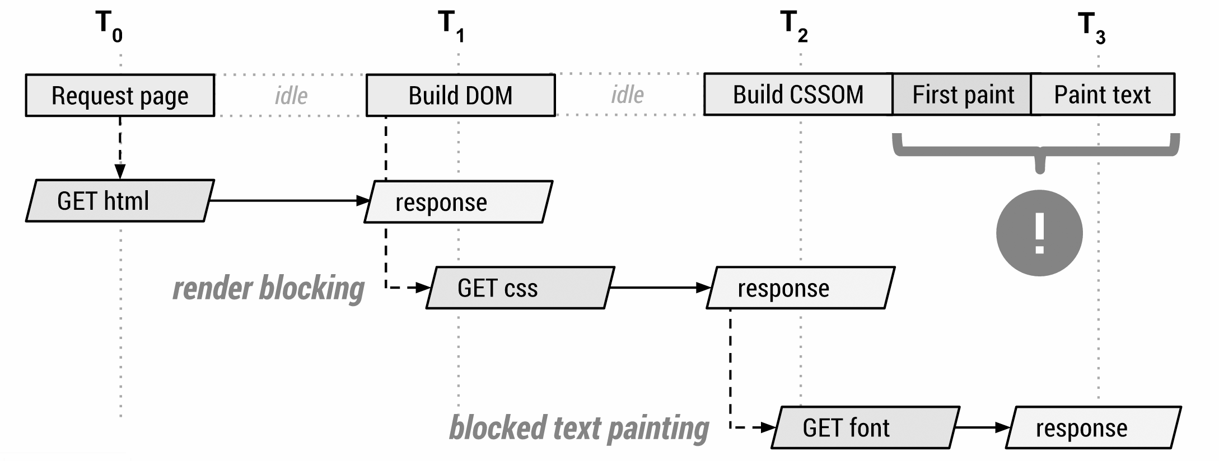
CRITICAL RENDERING PATH
19
#WordCampSkopje2019 @emilijagjorgjevska

Slide 21
THE END GOAL IS IMPROVED WEBPAGE SPEED
20
#WordCampSkopje2019 @emilijagjorgjevska

Slide 22
COMMON MISCONCEPTIONS
WebpageTest, GTMetrix, Pingdom!
Google PageSpeed Insights?
21
#WordCampSkopje2019 @emilijagjorgjevska

Slide 23
BENEFIT: SATISFIED USERS
22
#WordCampSkopje2019 @emilijagjorgjevska

Slide 24
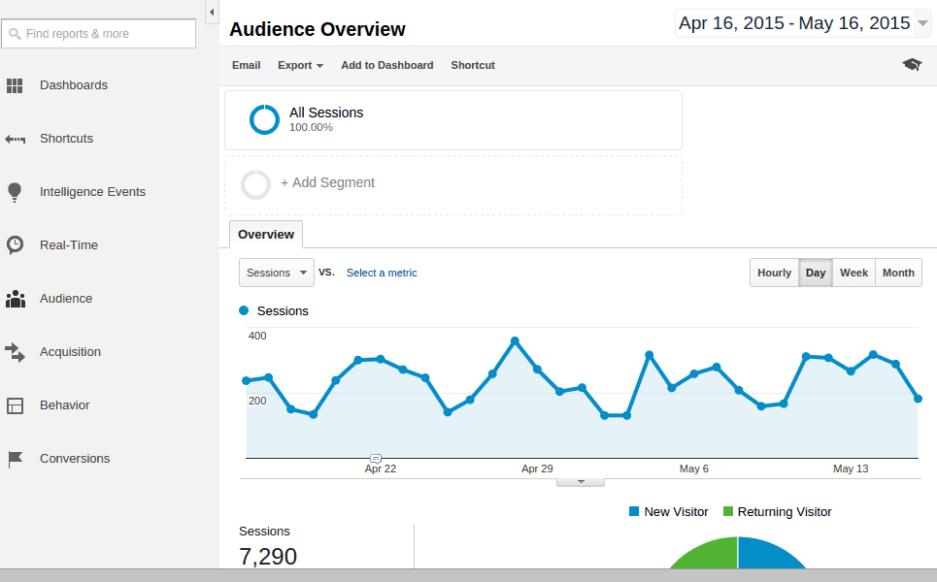
DOES GOOGLE ANALYTICS KNOW…
ALL?
23
#WordCampSkopje2019 @emilijagjorgjevska

Slide 25
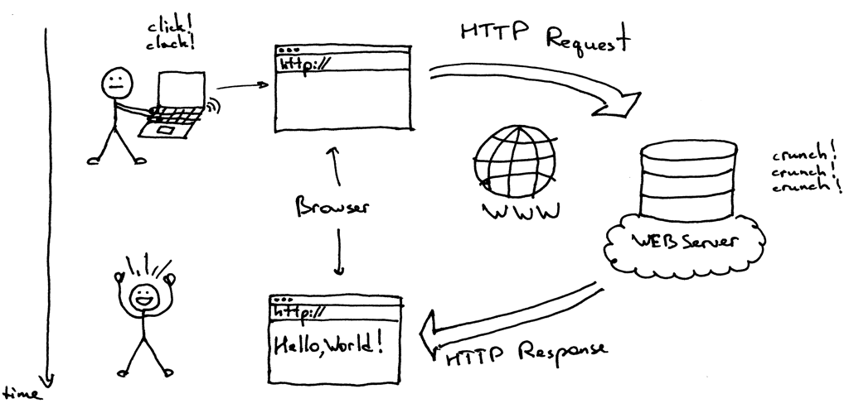
24
#WordCampSkopje2019 @emilijagjorgjevska

Slide 26
COMMON MISCONCEPTIONS ABOUT GA
25
#WordCampSkopje2019 @emilijagjorgjevska

Slide 27
LOST TRAFFIC
26
#WordCampSkopje2019 @emilijagjorgjevska

Slide 28
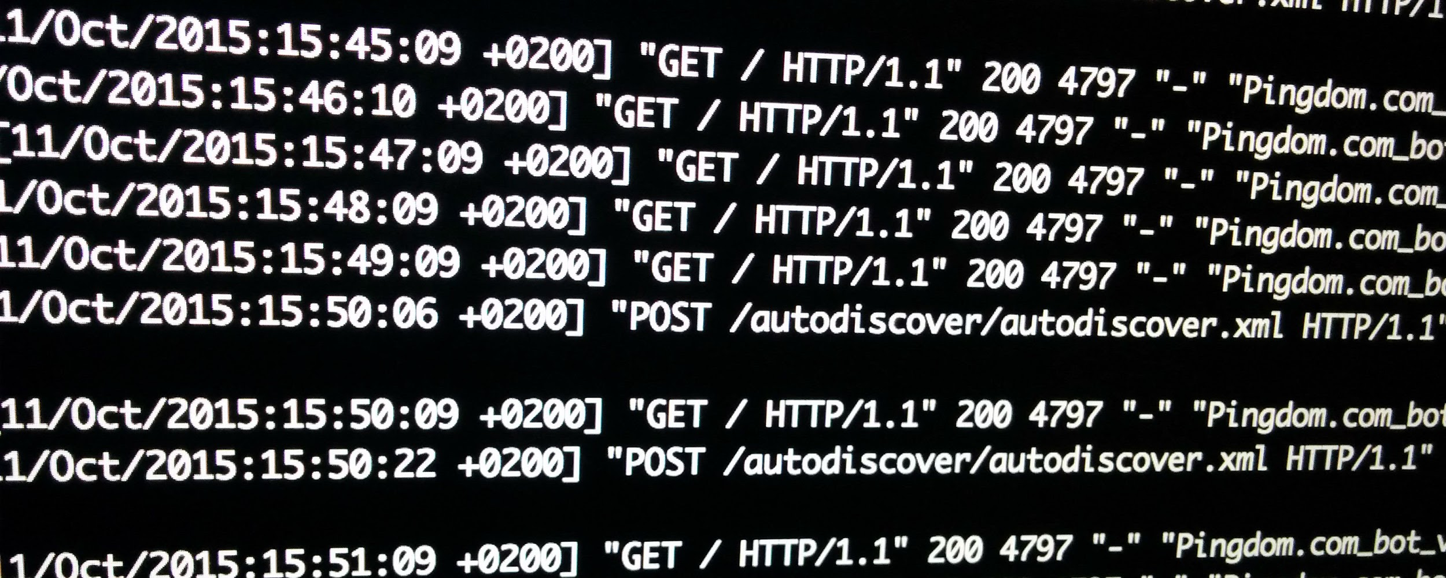
SERVER ACCESS LOG FILES
27
#WordCampSkopje2019 @emilijagjorgjevska

Slide 29
CRAWLERS ARE FED WITH CONTENT
28
#WordCampSkopje2019 @emilijagjorgjevska

Slide 30
HOW SEARCH WORKS
29
#WordCampSkopje2019 @emilijagjorgjevska

Slide 31
30
#WordCampSkopje2019 @emilijagjorgjevska

Slide 32
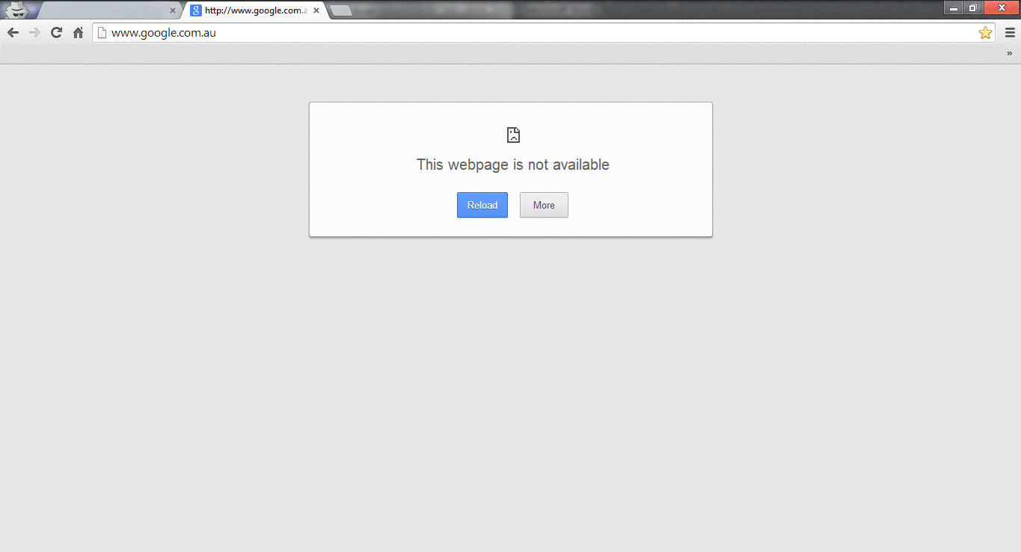
CAREFUL.
31
#WordCampSkopje2019 @emilijagjorgjevska

Slide 33
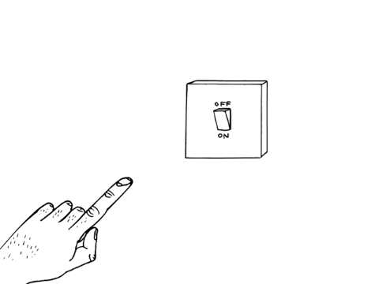
BENEFIT: EXCLUDE INVALUABLE PAGES
32
#WordCampSkopje2019 @emilijagjorgjevska

Slide 34
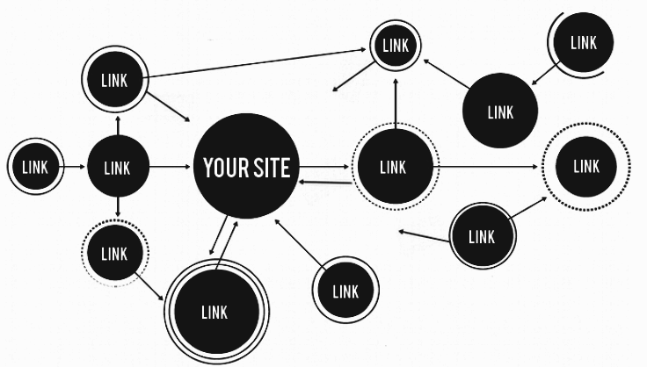
THANKS TO RECRUITERS...
33
#WordCampSkopje2019 @emilijagjorgjevska

Slide 35
I DISCOVERED ADVANCED QUERY OPERATORS
related: returns other websites that are similar to the queried word/s.
site: returns only search results from the entered website.
allinanchor: returns the pages that have those specific keyword/s in anchor tags.
allintext: return only pages that have the query word/s in the body of the page.
allinurl: returns only pages that contain all of the query word/s in the URL.
allintitle: returns only pages that contain all of the query word/s in the title.
quotation marks (“”): returns only pages that contain the exact query word/s
~ operator: searches for results that also include synonyms of your query
34
#WordCampSkopje2019 @emilijagjorgjevska

Slide 36
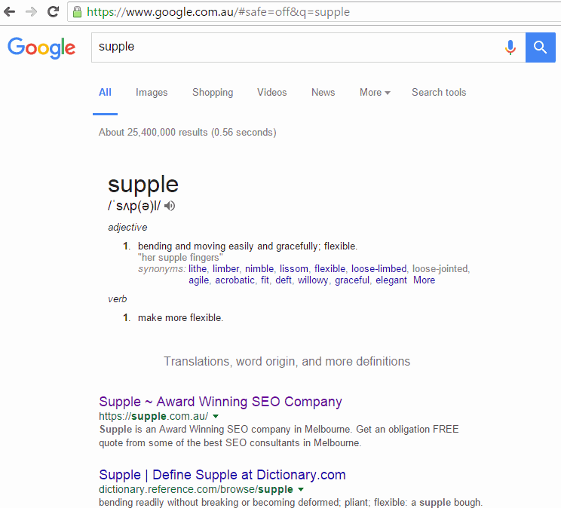
EXAMPLE:
SITE OPERATOR
35
#WordCampSkopje2019 @emilijagjorgjevska

Slide 37
BENEFIT: PERFECT FOR LINK BUILDING, INDEXED PAGES
36
#WordCampSkopje2019 @emilijagjorgjevska

Slide 38
ONTOLOGY
LINKS
ENTITIES
RDF
SEMANTIC SEO
RELATIONSHIPS
PHRASES
URIs
WORDS
TOPIC
37
#WordCampSkopje2019 @emilijagjorgjevska

Slide 39
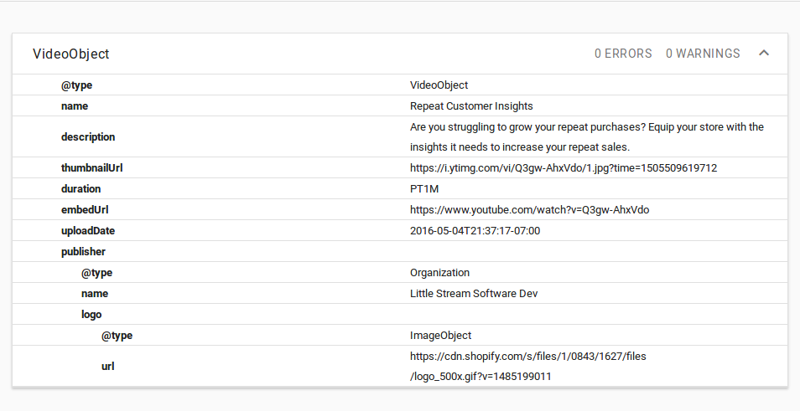
SCHEMA MARKUP
38
#WordCampSkopje2019 @emilijagjorgjevska

Slide 40
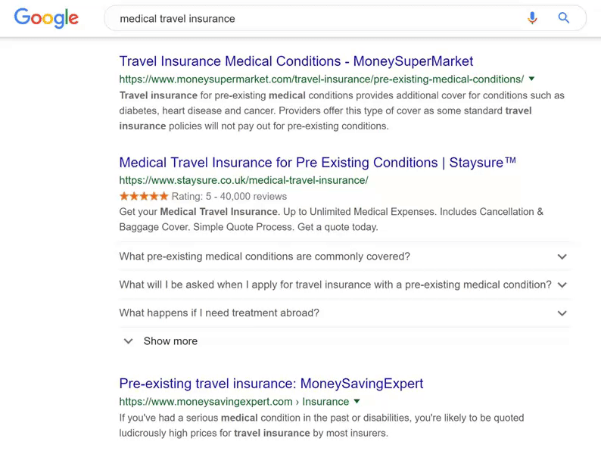
RICH SNIPPETS
39
#WordCampSkopje2019 @emilijagjorgjevska

Slide 41
TOPIC CLUSTERS
My thesis:
"SEO optimization for Google Discover with NLP techniques"
40
#WordCampSkopje2019 @emilijagjorgjevska

Slide 42
NETWORK OF LINKS
41
#WordCampSkopje2019 @emilijagjorgjevska

Slide 43
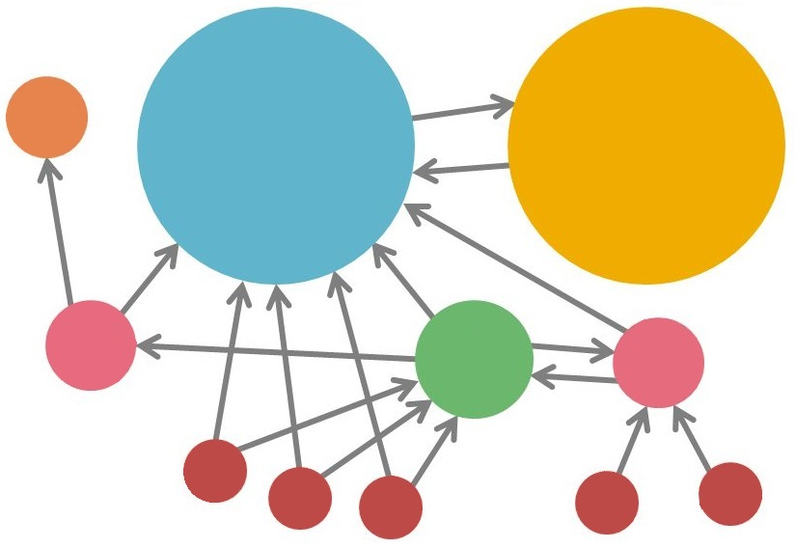
PAGE RANK
A
3.3
B
38.4
C
34.3
D
3.9
E
8.1
F
3.9
1.6
1.6
1.6
1.6
1.6
42
#WordCampSkopje2019 @emilijagjorgjevska

Slide 44
BENEFIT: IMPROVED UNDERSTANDING
43
#WordCampSkopje2019 @emilijagjorgjevska

Slide 45
SEO HAS A LOT TO DO WITH PROGRAMMING
44
#WordCampSkopje2019 @emilijagjorgjevska

Slide 46
AND MACHINE LEARNING
45
#WordCampSkopje2019 @emilijagjorgjevska

Slide 47
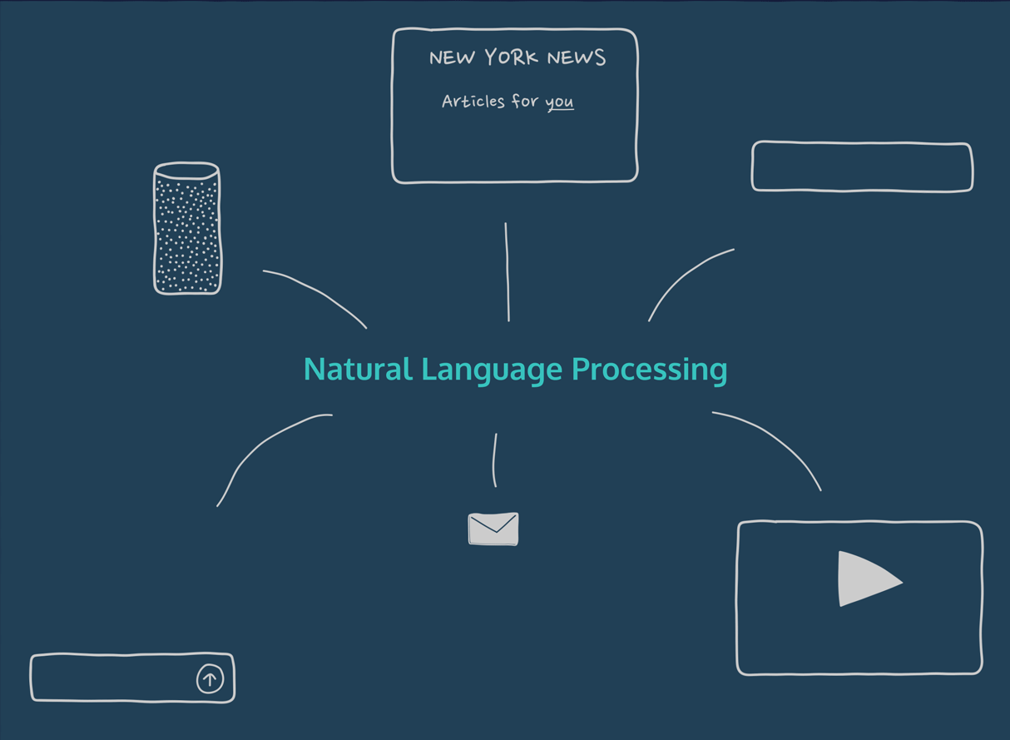
...AND NATURAL LANGUAGE PROCESSING
46
#WordCampSkopje2019 @emilijagjorgjevska

Slide 48
Apply data science principles
and frameworks to (tech) SEO
47
#WordCampSkopje2019 @emilijagjorgjevska

Slide 49
BENEFIT: AUTOMATION AND INFORMED DECISIONS
48
#WordCampSkopje2019 @emilijagjorgjevska

Slide 50
HYBRID
Historically, it’s been here
(tech) SEO
DATA SCIENCE
MARKETING
PROGRAMMING
49
#WordCampSkopje2019 @emilijagjorgjevska

Slide 51
HYBRID
DATA SCIENCE
(tech) SEO
MARKETING
PROGRAMMING
Ideally, it should be here
50
#WordCampSkopje2019 @emilijagjorgjevska

Slide 52
HYBRID
(tech) SEO
DATA SCIENCE
MARKETING
PROGRAMMING
At least - be here
51
#WordCampSkopje2019 @emilijagjorgjevska

Slide 53
INVEST IN TECHNICAL SEO
ENGINEERS!
not in technical seo
53
52
#WordCampSkopje2019 @emilijagjorgjevska

Slide 54
An SEO strategy is only good as
the data and insights it’s based on.
53
#WordCampSkopje2019 @emilijagjorgjevska

Slide 55
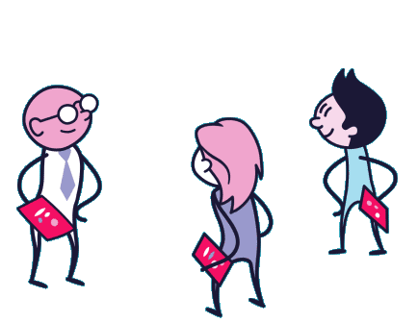
SEO = COLLABORATION.
WE NEED ALL TYPES OF SEOs :)
54
#WordCampSkopje2019 @emilijagjorgjevska

Slide 56
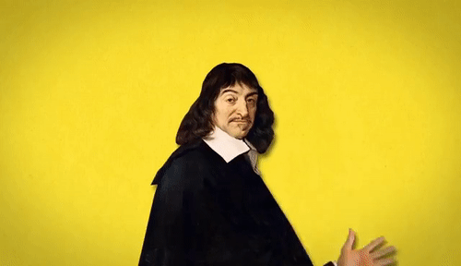
SEO IS A LIFE PHILOSOPHY
55
#WordCampSkopje2019 @emilijagjorgjevska

Slide 57
UPDATE
QUALITY
LEARN
OUTRANKED?
OUTDATED?
DOMAIN AUTHORITY
CONNECT
ADAPT
56
#WordCampSkopje2019 @emilijagjorgjevska

Slide 58
BE REGENERATIVE.
57
#WordCampSkopje2019 @emilijagjorgjevska

Slide 59
HAPPY SEOING!
“Work, have fun and laugh along the way” - ME. EMI.

Slide 60
11
#WordCampSkopje2019 @emilijagjorgjevska

