Slide 1
Can your site handle 100,000 real-time users?
WordCamp Skopje
Vladimir Novachki

Slide 2

About me
Branched Deployment
WordCamp Skopje 2018

Slide 3

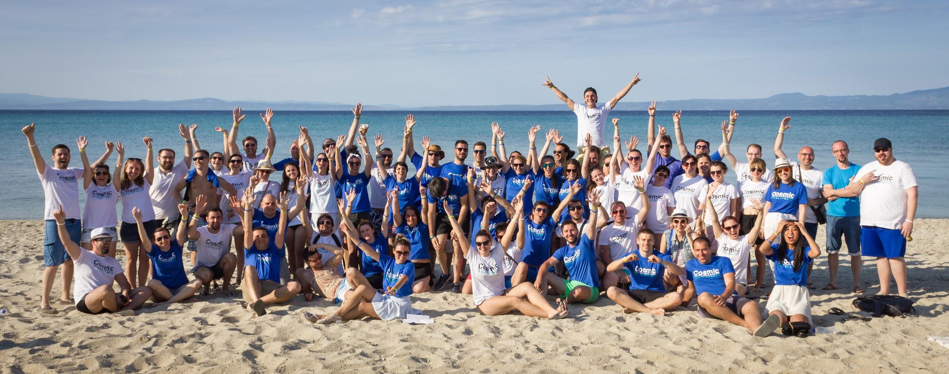
About me
Chief Technology Officer @

Slide 4
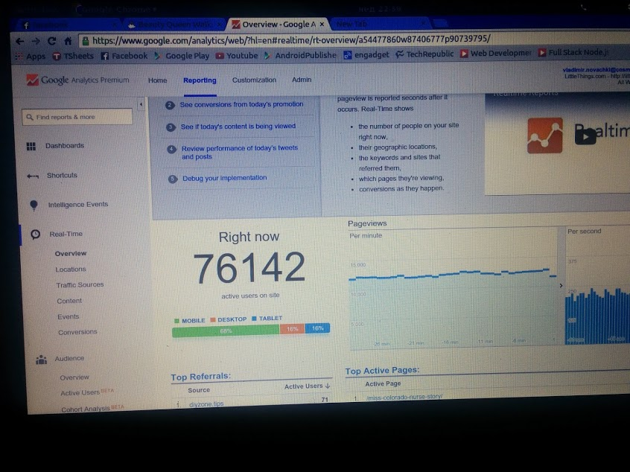

Slide 5
Why to scale?

Slide 6

Ouch!

Slide 7
What are the consequences?
You will lose your visitors
You will lose your revenue

Slide 8

I’m sorry

Slide 9
Optimization strategy
Code optimization
Managing static resources
Database optimization and caching layer
Build a proper server architecture

Slide 10

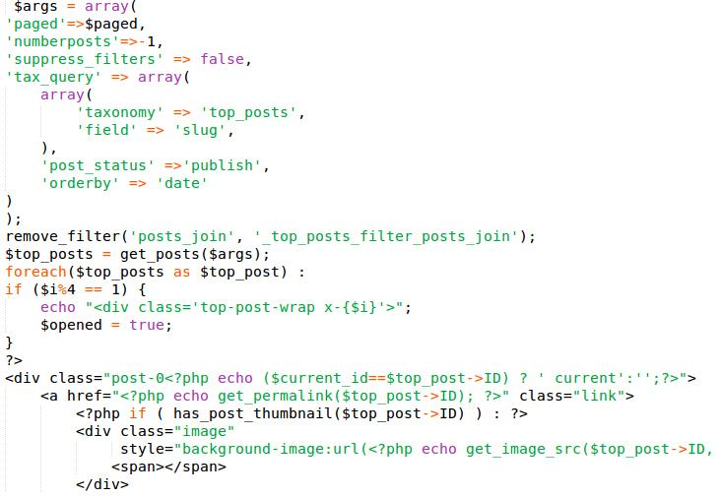
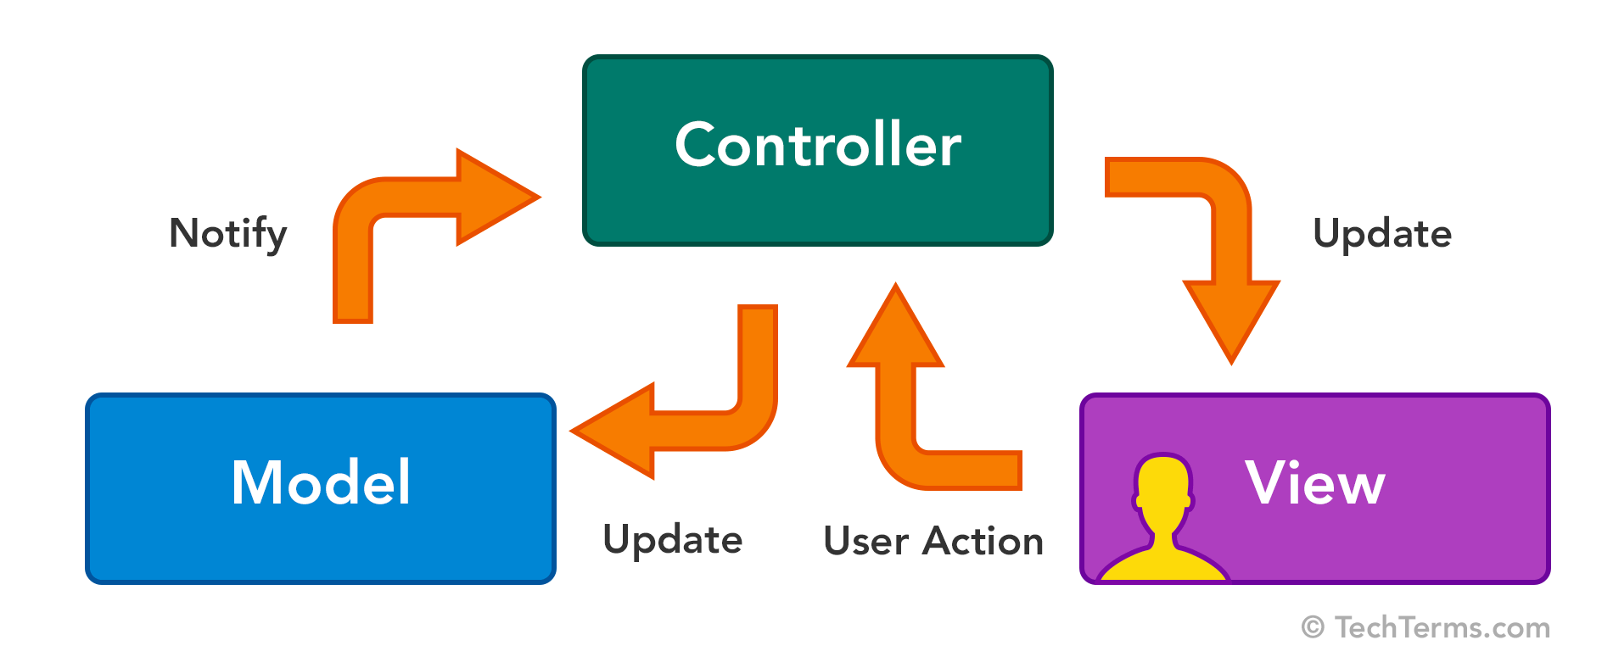
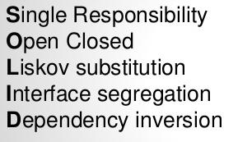
Code optimization
single.php

Slide 11


Slide 12
Object Oriented Programming

Slide 13
https://www.wordcampskopje.com/rss
<?php
syslog(LOG_DEBUG, "The Rss Class has been included");
class Rss
{
public function __construct()
{
}
privite function someMethod()
{
}
}

Slide 14
https://www.wordcampskopje.com/login
<?php
syslog(LOG_DEBUG, "The FacebookLogin Class has been included");
class FacebookLogin
{
public function __construct()
{
}
privite function someMethod()
{
}
}

Slide 15
functions.php
<?php
require_once( __DIR__ . '/includes/Rss.php');
require_once( __DIR__ . '/includes/FacebookLogin.php');
require_once( __DIR__ . '/includes/TwitterLogin.php');
require_once( __DIR__ . '/includes/MySlider.php');
require_once( __DIR__ . '/includes/YahooFeed.php');
require_once( __DIR__ . '/includes/MsnFeed.php');
require_once( __DIR__ . '/includes/MyMinifier.php');
require_once( __DIR__ . '/includes/AdsManager.php');
require_once( __DIR__ . '/includes/TopStory.php');
require_once( __DIR__ . '/includes/MyCache.php');

Slide 16
https://www.wordcampskopje.com/about-us
The Rss Class has been included
The FacebookLogin Class has been included
The TwitterLogin Class has been included
The MySlider Class has been included
The YahooFeed Class has been included
The MsnFeed Class has been included
The MyMinifier Class has been included
The AdsManager Class has been included
The TopStory Class has been included
The MyCache Class has been included

Slide 17
Autoloading
At the heart of autoloading mechanism is PHP’s built in spl_autoload_register function. All it does is register a function to be called automatically when your code references a class that hasn’t been loaded yet.

Slide 18
https://www.wordcampskopje.com/about-us
The AdsManager Class has been included

Slide 19
Bedrock
WordPress boilerplate with modern development tools, easier configuration, and an improved folder structure.

Slide 20
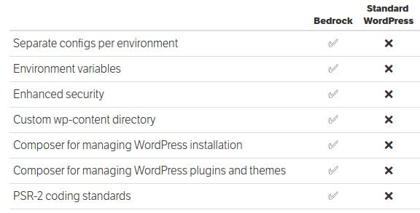

Slide 21
Managing static resources

Slide 22
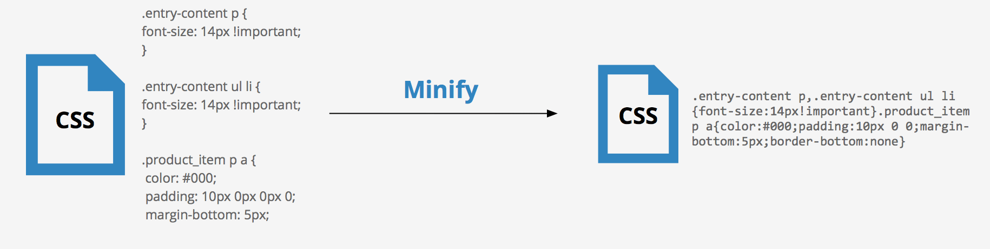
Js and CSS Minification

Slide 23
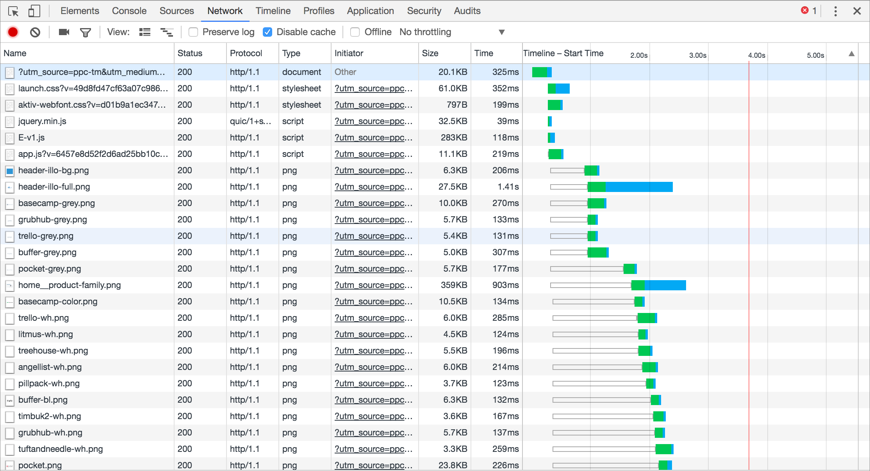
~6 parallel downloads per host
Limitation of the HTTP protocol

Slide 24
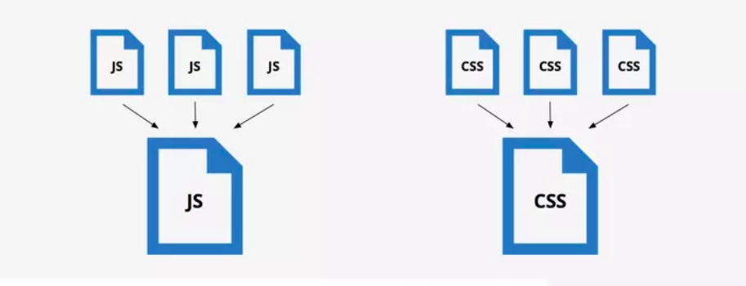
Combine Javascript and CSS files

Slide 25
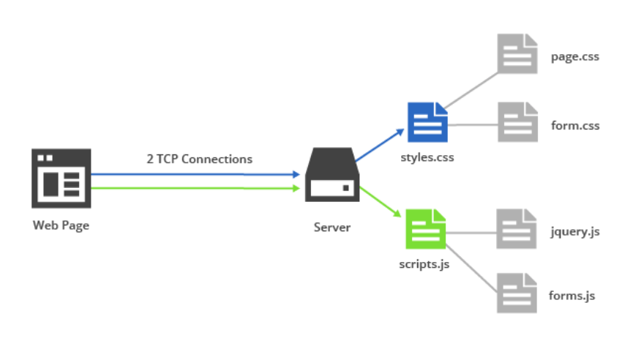
Reduce number of requests

Slide 26
What about the images and videos?

Slide 27
Content Delivery Network
https://cdn.wordcampskopje.com/

Slide 28
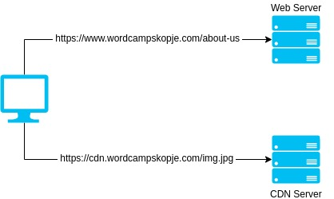
CDN

Slide 29
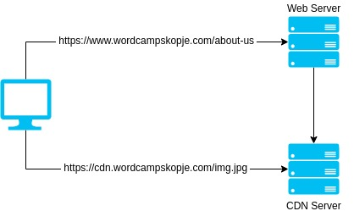
CDN Push

Slide 30
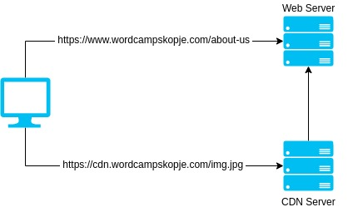
CDN Pull

Slide 31
~6 parallel downloads per host

Slide 32
~6 parallel downloads per host
https://www.wordcampskopje.com
https://cdn.wordcampskopje.com

Slide 33
Domain sharding
https://cdn.wordcampskopje.com
https://cdn1.wordcampskopje.com
https://cdn2.wordcampskopje.com
https://cdn3.wordcampskopje.com
.
.
.
.
https://cdn10.wordcampskopje.com

Slide 34
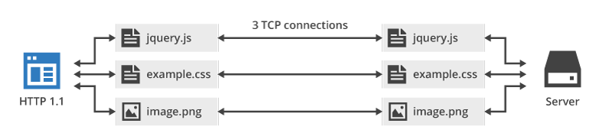
New TCP connection for each request

Slide 35
HTTP/2

Slide 36
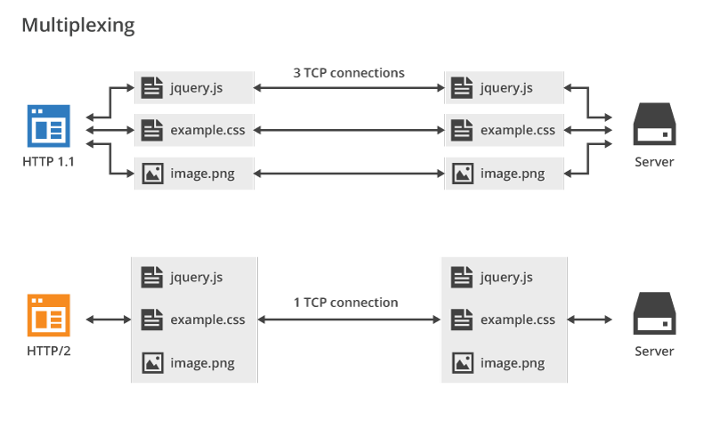
HTTP/2 Multiplexing

Slide 38
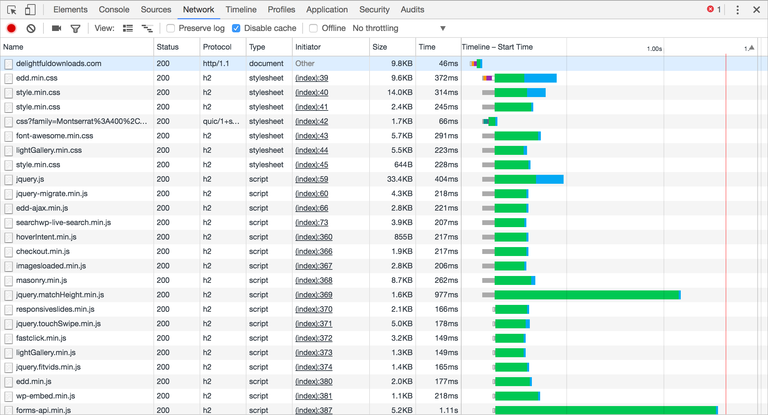

Slide 39
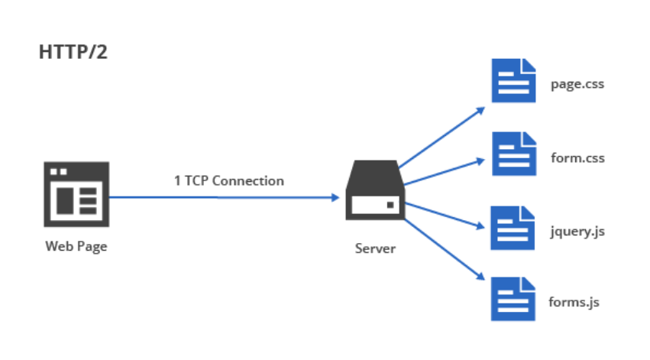
HTTP/2 Multiplexing

Slide 40
How to enable HTTP/2
server {
listen 443 ssl http2;
listen [::]:443 ssl http2;
server_name example.com;
root /path/to/public;
ssl_certificate /path/to/certificate.crt;
ssl_certificate_key /path/to/private.key;
ssl_protocols TLSv1.2;
}

Slide 41
Database optimization

Slide 42
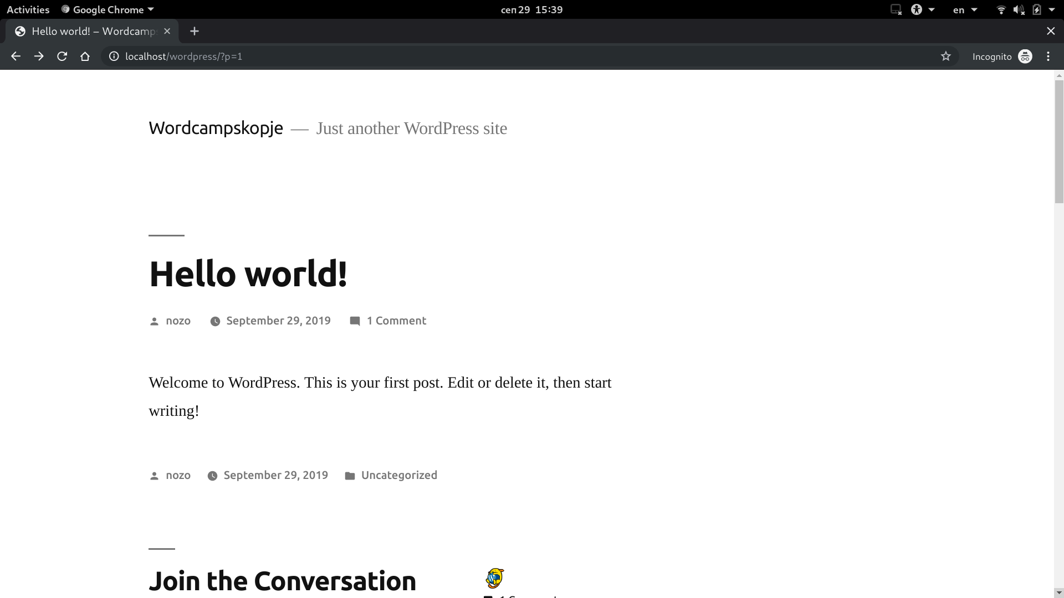

Slide 43
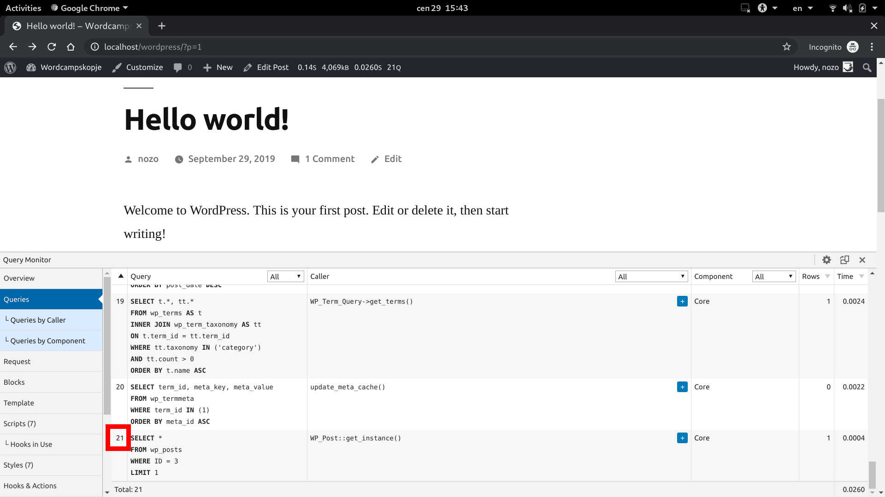


Slide 44
Database optimizations
Use WP_Object_Cache
Use Redis/Memcache
Don't use a plugin for every single functionality

Slide 45
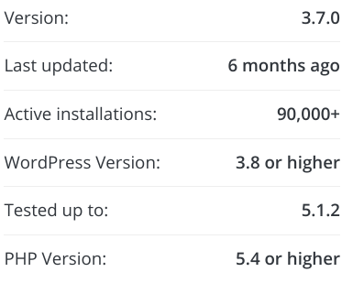
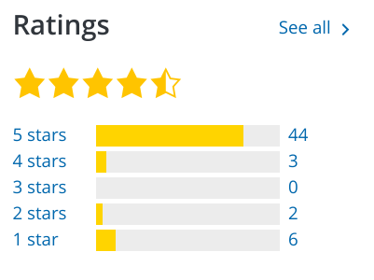
Don't rely on plugins

Slide 46
Don't rely on plugins
protected function _get_attachment_id($image_url)
{
return self::execute_query(
$this->__db->prepare( "SELECT ID FROM " . $this->__db->posts . "
WHERE post_type='attachment'
AND guid = %s", $image_url ));

Slide 47
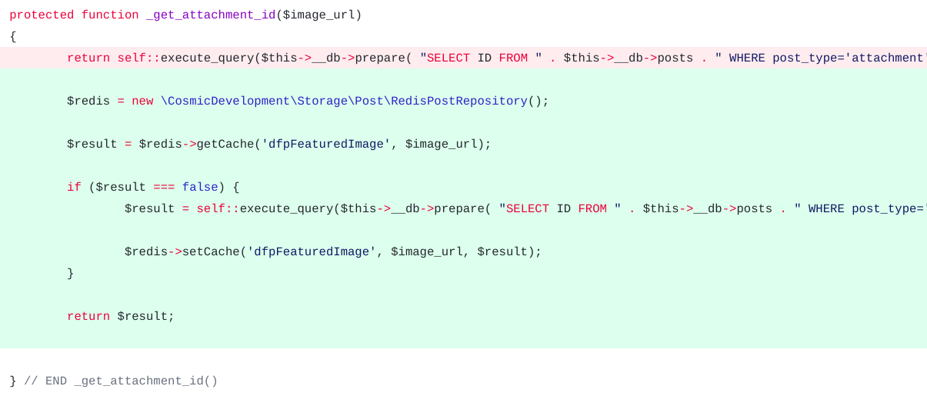
Don't rely on plugins

Slide 48
Build a proper server architecture

Slide 49
WordPress Hosting
WordPress-optimized architecture designed to meet best practices in security, reliability, and performance

Slide 50

WordPress Hosting
WordPress-optimized architecture designed to meet best practices in security, reliability, and performance

Slide 51
White Labeling

Slide 52
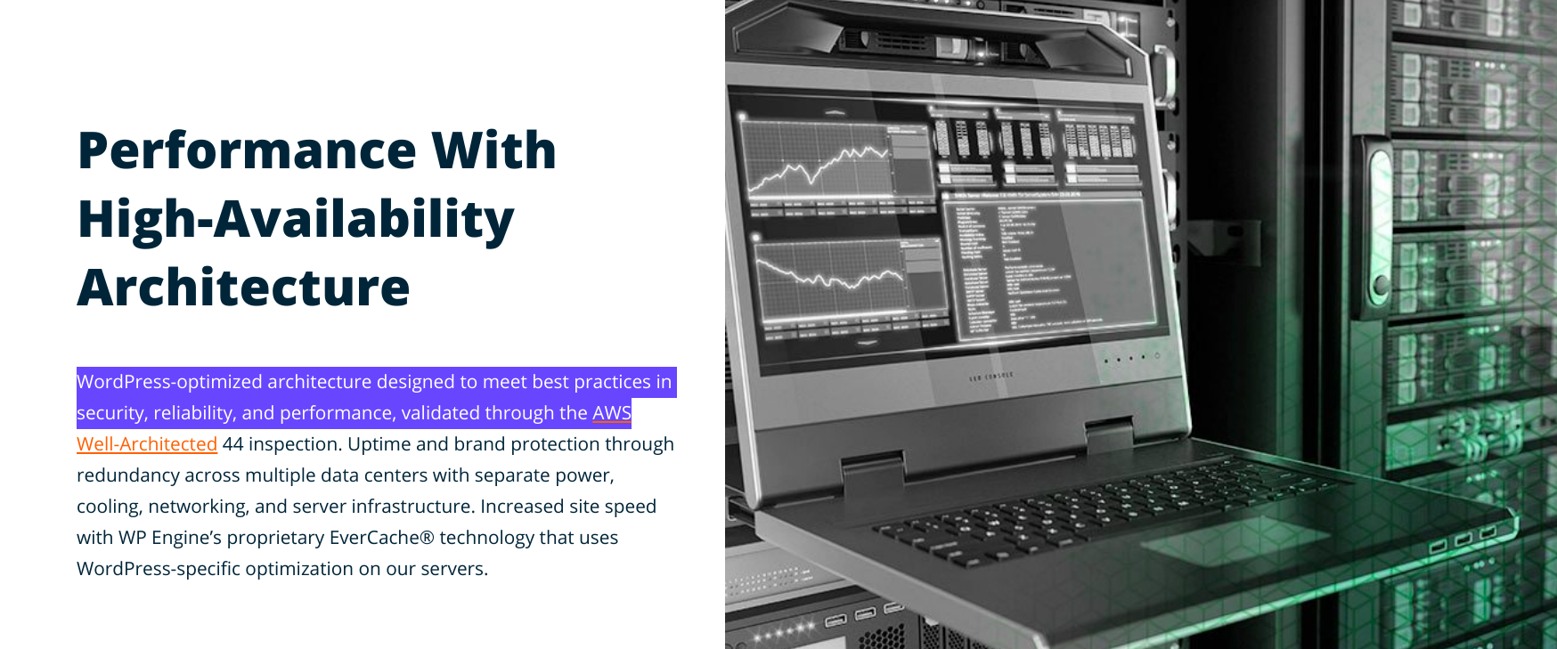

Slide 53
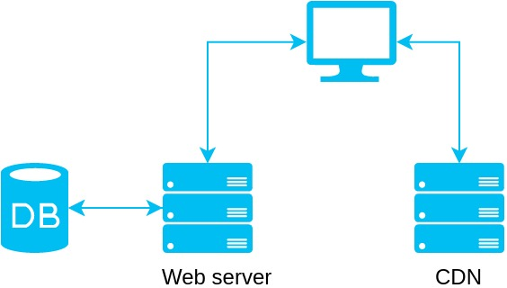
Server architecture - foundation

Slide 54
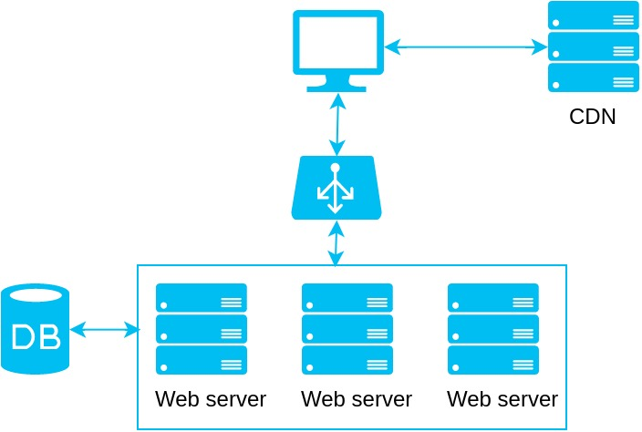
Load balancer
Auto Scaling

Slide 55
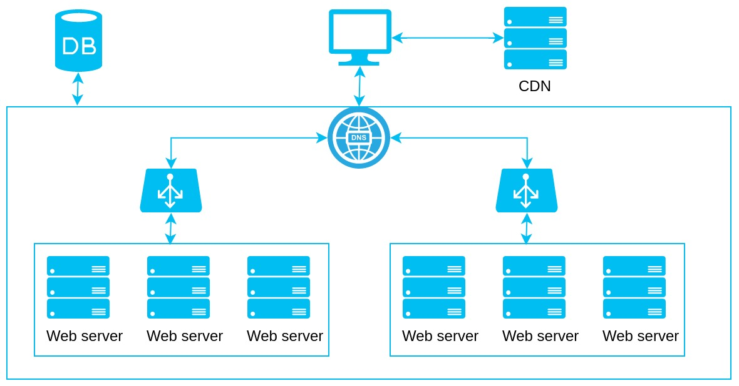
DNS Load Balancing
Geolocation routing policy

Slide 56
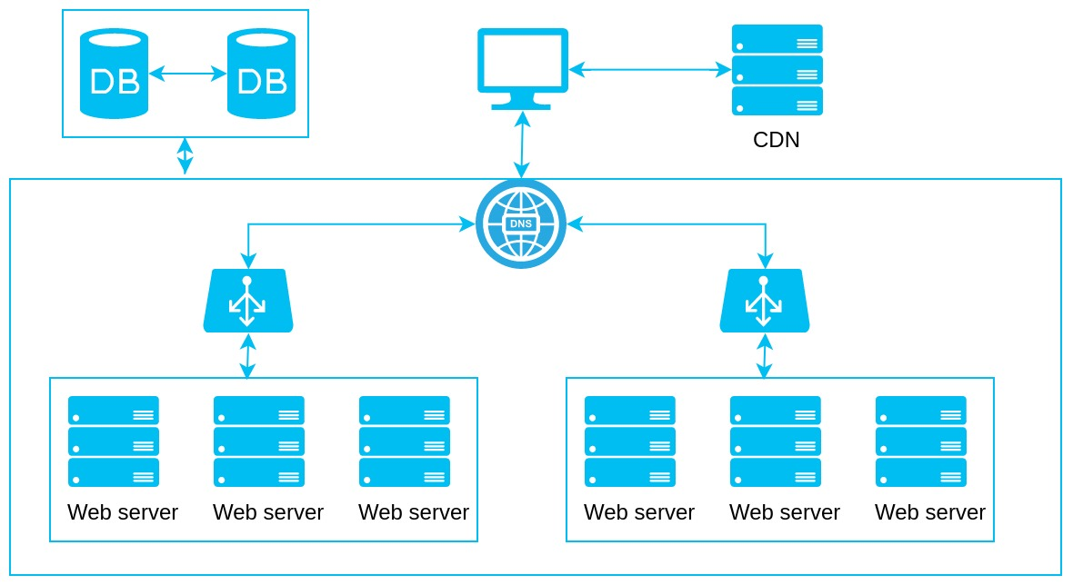
MySQL replication
Master-Master
Master-Slave
HyperDB

Slide 57
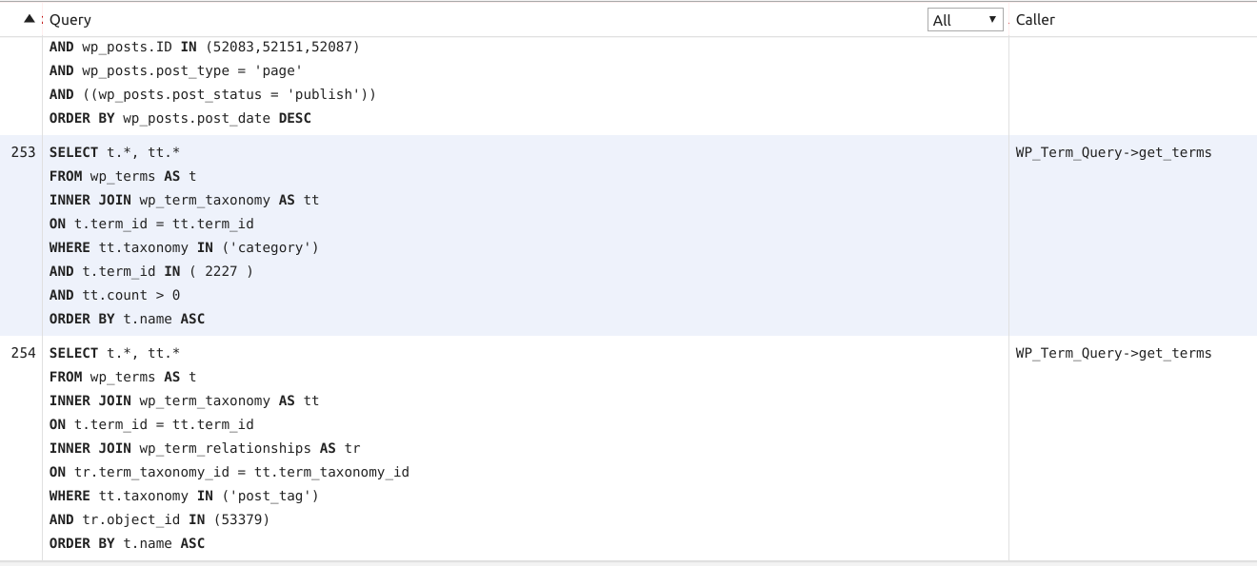
Optimization is still needed

Slide 58
Page caching

Slide 59
Nginx FastCGI Cache
fastcgi_cache_path /etc/nginx/cache levels=1:2 keys_zone=phpcache:100m max_size=10g inactive=60m ;
fastcgi_cache_key "$scheme$request_method$host$request_uri";

Slide 60
Stuff that should not be cached
# POST requests and urls with a query string should always go to PHP
if ($request_method = POST) {
set $skip_cache 1;
}
# Don't cache uris containing the following segments
if ($request_uri ~* "/wp-admin/|wp-.*.php|^/feed/*|/tag/.*/feed/*|index.php|/.*sitemap.*\.(xml|xsl)") {
set $skip_cache 1;
}
# Don't use the cache for logged in users or recent commenters
if ($http_cookie ~* "comment_author|wordpress_[a-f0-9]+|wp-postpass|wordpress_no_cache|wordpress_logged_in") {
set $skip_cache 1;
}

Slide 61
Serve FastCGI cache from RAM memory
fastcgi_cache_path /etc/nginx/cache levels=1:2 keys_zone=phpcache:100m max_size=10g inactive=60m ;
fastcgi_cache_key "$scheme$request_method$host$request_uri";
vim /etc/fstab
tmpfs /etc/nginx/cache tmpfs defaults,size=100M 0 0
mount -a

Slide 62
Conclusion
Don’t write spaghetti code
Don't use a plugin for every single functionality
Use proper caching
Challenge and big responsibility

Slide 63
header("HTTP/1.1 404 Next Slide Not Found");
Thank you!

Slide 64
header("HTTP/1.1 404 Next Slide Not Found");
Questions!?

